Slide 1

COMPUTER NETWORKS
20CS3501
DAYANANDA SAGAR UNIVERSITY
DEPARTMENT OF COMPUTER SCIENCE & ENGINEERING SCHOOL OF ENGINEERING
DAYANANDA SAGAR UNIVERSITY KUDLU GATE
BANGALORE - 56006
IP ADDRESSING , IP PACKET FORMAT IPV4

Slide 2
Presented By
VINOD V - ENG20CS0413
VIVEK BELAGALI – ENG20CS0414
IKSHWAK VARMA - ENG20CS0415
YASH C - ENG20CS0416
YASHASWINI C – ENG20CS0417
YOGDEEP G – ENG20CS0418
Under the Guidance of
Prof. AMBESHWAR KUMAR

Slide 3
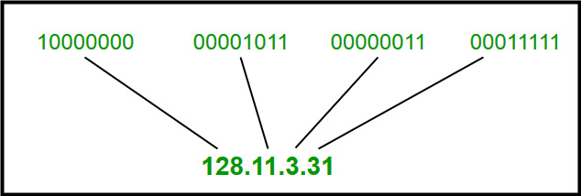
IP Addresses
IP address is an address having information about how to reach a specific host, especially outside the LAN. An IP address is a 32 bit unique address having an address space of 2³².
Generally, there are two notations in which IP address is written, dotted decimal notation and hexadecimal notation.
Dotted Decimal Notation:

Slide 4
Classful Addressing
The 32-bit IP address is divided into five sub-classes. These are:
Class A
Class B
Class C
Class D
Class E
Each of these classes has a valid range of IP addresses. Classes D and E are reserved for multicast and experimental purposes respectively.
The order of bits in the first octet determine the classes of IP address. The order of bits in the first octet determine the classes of IP address.

Slide 5
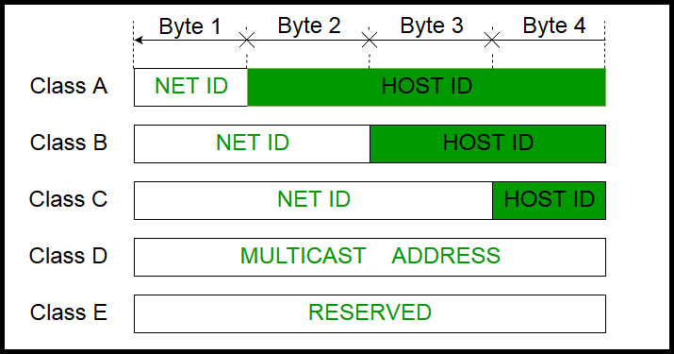
IPv4 address is divided into two parts:
Network ID
Host ID
The class of IP address is used to determine the bits used for network ID and host ID and the number of total networks and hosts possible in that particular class.

Slide 6
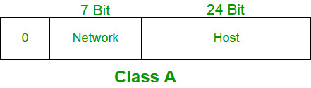
Class A:
IP address belonging to class A are assigned to the networks that contain a large number of hosts.
The network ID is 8 bits long.
The host ID is 24 bits long.
The higher order bit of the first octet in class A is always set to 0. The remaining 7 bits in first octet are used to determine network ID. The 24 bits of host ID are used to determine the host in any network.
The default subnet mask for class A is 255.x.x.x. Therefore, class A has a total of:
2^7-2= 126 network ID(Here 2 address is subtracted because 0.0.0.0 and 127.x.y.z are special address. )
2^24 – 2 = 16,777,214 host ID
IP addresses belonging to class A ranges from 1.x.x.x – 126.x.x.x

Slide 7
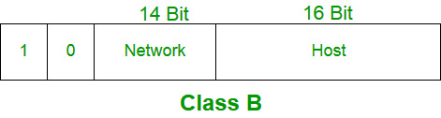
Class B:
IP address belonging to class B are assigned to the networks that ranges from medium-sized to large-sized networks.
The network ID is 16 bits long.
The host ID is 16 bits long.
The higher order bits of the first octet of IP addresses of class B are always set to 10. The remaining 14 bits are used to determine network ID. The 16 bits of host ID is used to determine the host in any network. The default sub-net mask for class B is 255.255.x.x. Class B has a total of:
2^14 = 16384 network address
2^16 – 2 = 65534 host address
IP addresses belonging to class B ranges from 128.0.x.x – 191.255.x.x.

Slide 8
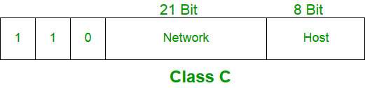
Class C:
IP addresses belonging to class C are assigned to small-sized networks.
  The network ID is 24 bits long.
  The host ID is 8 bits long.
The higher order bits of the first octet of IP addresses of class C are always set to 110. The remaining 21 bits are used to determine network ID. The 8 bits of host ID is used to determine the host in any network. The default sub-net mask for class C is 255.255.255.x. Class C has a total of:
  2^21 = 2097152 network address
  2^8 – 2 = 254 host address
IP addresses belonging to class C ranges from 192.0.0.x – 223.255.255.x.

Slide 9
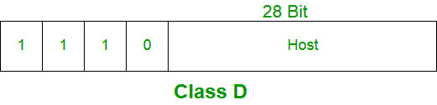
Class D:
IP address belonging to class D are reserved for multi-casting.
The higher order bits of the first octet of IP addresses belonging to class D are always set to 1110.
The remaining bits are for the address that interested hosts recognize.
Class D does not posses any sub-net mask. IP addresses belonging to class D ranges from 224.0.0.0 – 239.255.255.255.

Slide 10
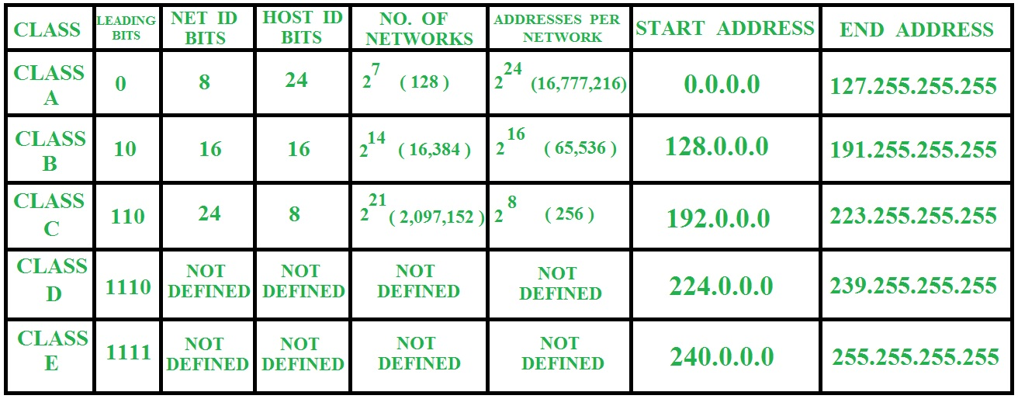

Slide 11
DETAILS OF IP PACKET
An IP packet is the smallest message entity exchanged via the Internet Protocol across an IP network.
IP packets consist of a header for addressing and routing, and a payload for user data.
The header contains information about IP version, source IP address, destination IP address, time-to-live, etc.

Slide 12
IPv4:
IPv4 is a connectionless protocol used for packet-switched networks.
It operates on a best effort delivery model, in which neither delivery is guaranteed, nor proper sequencing or avoidance of duplicate delivery is assured.
Internet Protocol Version 4 (IPv4) is the fourth revision of the Internet Protocol and a widely used protocol in data communication over different kinds of networks.
IPv4 is a connectionless protocol used in packet-switched layer networks, such as Ethernet.
It provides a logical connection between network devices by providing identification for each device.
There are many ways to configure IPv4 with all kinds of devices – including manual and automatic configurations – depending on the network type.

Slide 13
IPv4 is defined and specified in IETF publication RFC 791.
IPv4 uses 32-bit addresses for Ethernet communication in five classes: A, B, C, D and E.
Classes A, B and C have a different bit length for addressing the network host.
Class D addresses are reserved for military purposes, while class E addresses are reserved for future use.
IPv4 uses 32-bit (4 byte) addressing, which gives 2³² addresses.
IPv4 addresses are written in the dot-decimal notation, which comprises of four octets of the address expressed individually in decimal and separated by periods, for instance, 192.168.1.5.

Slide 14
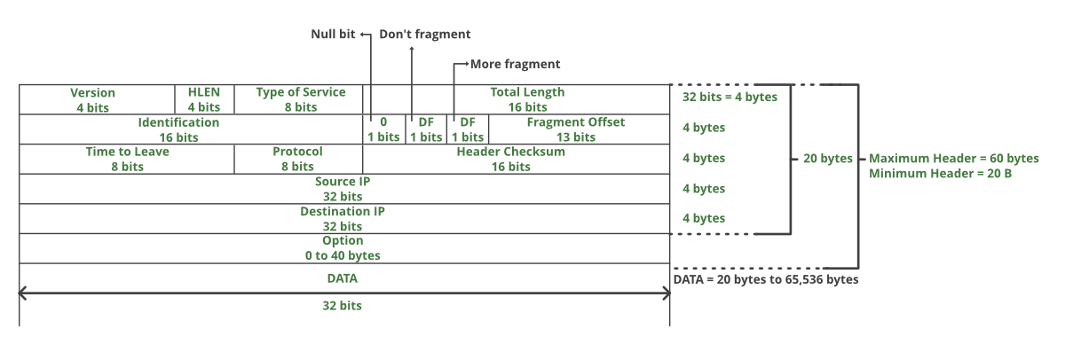

Slide 15
THANK YOU

